Slide 1
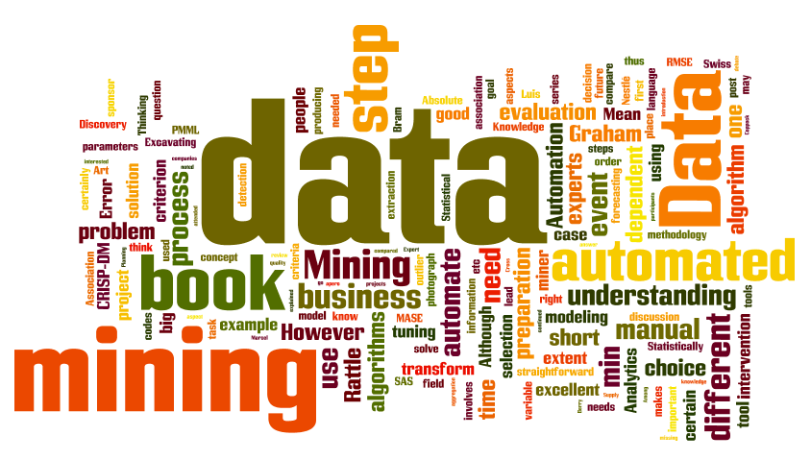
IT-533: Data Mining
Week 5
Sonja Streuber

Slide 2
Reading Summary
Han/ Kamber 6
Witten/ Eibe 3, 4.1, 17.2

Slide 3
Agenda
# | Topic | Reading | Due by Sun 11:59 pm CST on Blackboard
5 | Patterns, Associations, Correlations: Frequent Itemsets, Apriori, Support and Confidence Measures, Recommender Systems | Han/ Kamber 6 Witten/Eibe 3, 4.1, 17.2 Zhao 9 Ledolter 16 (Market Basket Analysis) YouTube videos as posted | MW Quiz 5: Recommender systems S: FINAL_PROJECT_5: Using R or Python, preprocess your dataset to run with Apriori. Show and describe the output. What do the results tell you about the attributes in your dataset?

Slide 4
Association analysis

Slide 5
Mining Frequent Patterns, Association and Correlations
Basic Concepts
Frequent Itemset Mining Methods
Which Patterns Are Interesting?—Pattern Evaluation Methods
Summary

Slide 6



Association Analysis
Association Rule Learning (also called Association Rule Mining) is a common technique used to find associations between many variables.
Often used by grocery stores, retailers, and anyone with a large transactional databases.
It’s the same way that Target knows you are pregnant or when you’re buying an item on Amazon.com they know what else you want to buy. The same idea extends to Pandora.com knowing what song you want to listen to next.
All of these incorporate, at some level, data mining concepts and association rule algorithms

Slide 7
Frequent Patterns (FP)
An intrinsic and important property of datasets
Foundation for many essential data mining tasks
Association, correlation, and causality analysis
Sequential, structural (e.g., sub-graph) patterns
Pattern analysis in spatiotemporal, multimedia, time-series, and stream data
Classification: discriminative, frequent pattern analysis
Cluster analysis: frequent pattern-based clustering
Data warehousing: iceberg cube and cube-gradient
Semantic data compression: fascicles
Broad applications

Slide 8
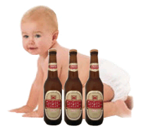
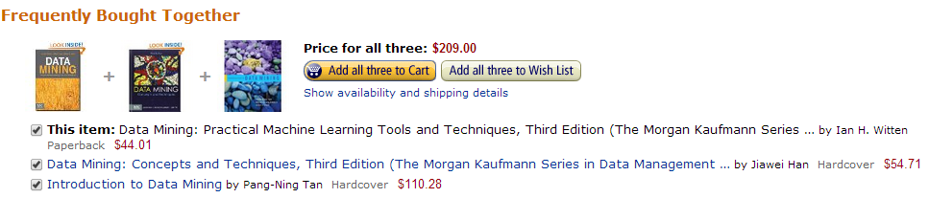
What Is Association Mining?
Association rule mining:
Finding frequent patterns, associations, correlations, or causal structures among sets of items or objects in transaction databases, relational databases, and other information repositories.
Frequent pattern: pattern (set of items, sequence, etc.) that occurs frequently in a database [AIS93]
Motivation: finding regularities in data
What products were often purchased together? — Beer and diapers?!
What are the subsequent purchases after buying a PC?
What kinds of DNA are sensitive to this new drug?
Can we automatically classify web documents?
Association Rules can predict any attribute and combination thereof, not just the class.

Slide 9
Vocabulary
Itemset: Set of items that occur together
Association Rule: Probability that particular items are purchased together.
X → Y where X ∩Y = 0
Support, supp(X) of an itemset X is the ratio of transactions in which an itemset appears to the total number of transactions.
Share of an itemset is the ratio of the count of items purchased together to the total count of items purchased in all transactions.
Confidence of rule X → Y, denoted conf(X → Y)
conf(X → Y) = supp(X ᴜ Y) / supp(X)
Confidence can also be defined in terms of the conditional probability.
conf(X → Y) = P(Y | X) = P(X ∩ Y) / P(X)
Transaction Database stores transaction data. Transaction data may also be stored in some other form than a m x n database.

Slide 10
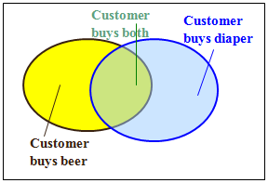
Association Rule Mining
Given a set of transactions, find rules, frequent patterns, associations, correlations, or co-occurrences that will predict the occurrence of an item based on the occurrences of other items in the transaction
Frequent pattern: pattern (set of items, sequence, etc.) that occurs frequently in a database [AIS93]
Example of Association Rules
Market-Basket transactions
{Diaper} → {Beer}, {Milk, Bread} → {Eggs,Coke}, {Beer, Bread} → {Milk},

Slide 11
Association Rules
Find all the rules X → Y with minimum support and confidence
support, s, probability that a transaction contains X ∪ Y
confidence, c, conditional probability that a transaction having X also contains Y
Let minsup = 50%, minconf = 50%
Freq. Pat.: Beer:3, Nuts:3, Diaper:4, Eggs:3, {Beer, Diaper}:3
Tid
Items bought
10
Beer, Nuts, Diaper
20
Beer, Coffee, Diaper
30
Beer, Diaper, Eggs
40
Nuts, Eggs, Milk
50
Nuts, Coffee, Diaper, Eggs, Milk
Customer
buys both
Customer
buys diaper
Association rules: (many more!)
Beer → Diaper (60%, 100%)
Diaper → Beer (60%, 75%)
Customer
buys beer

Slide 12
How Does Mining Association Rules Work?
Frequent Itemset Generation
Generate all itemsets whose support is ≥ minsup
Rule Generation
Generate high confidence rules from each frequent itemset, where each rule is a binary partitioning of a frequent itemset
Frequent itemset generation is still computationally expensive

Slide 13
Mining Frequent Patterns, Association and Correlations
Basic Concepts
Frequent Itemset Mining Methods
Which Patterns Are Interesting?—Pattern Evaluation Methods
Summary

Slide 14
Definition: Frequent Itemset
Itemset
A collection of one or more items
Example: {Milk, Bread, Diaper}
k-itemset
An itemset that contains k items
Support count (σ)
Frequency of occurrence of an itemset
E.g. σ({Milk, Bread, Diaper}) = 2
Support
Fraction of transactions that contain an itemset
E.g. s({Milk, Bread, Diaper}) = 2/5
Frequent Itemset
An itemset whose support is greater than or equal to a min_sup threshold
INTERESTINGNESS
Find all the rules Diaper→Beer with min confidence and support
support, s, probability that a transaction contains Diaper ∪ Beer
confidence, c, % of customers who purchased Diaper also bought Beer.

Slide 15
Frequent Itemset Generation
Given d items, there are 2^{d} possible candidate itemsets

Slide 16
Frequent Itemset Generation
Brute-force approach:
Each itemset in the lattice is a candidate frequent itemset
Count the support of each candidate by scanning the database. Each operation involves a pass through the dataset to count the item in each set.
Match each transaction against every candidate
Complexity ~ O(NMw) => Expensive since M = 2^{d} !!! May cause high disk I/O

Slide 17
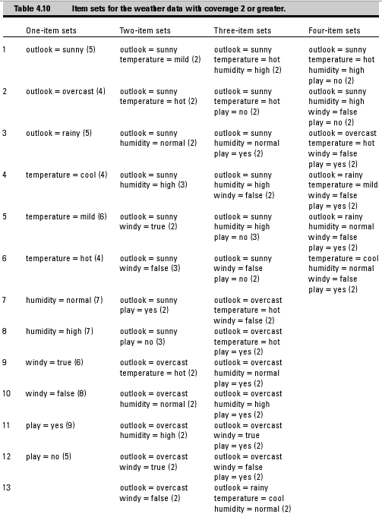
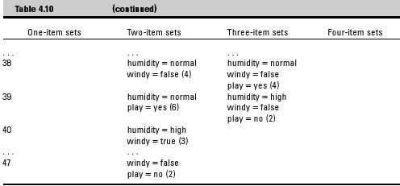
Example: Weka weather.nominal Dataset (14 instances, 5 attributes)
All combinations with minsup >= 2
47 two-item sets
39 three-item sets
6 four-item sets
92 item sets
Each of these item sets has its own set of rules describing all of its possible attribute configurations.

Slide 18
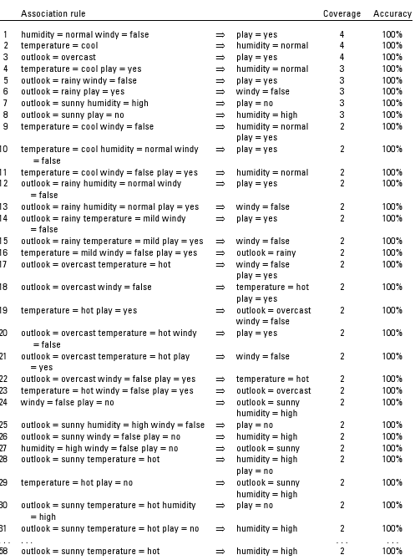
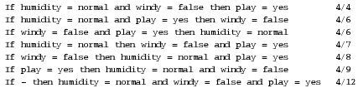
Example: Weka weather.nominal Dataset (14 instances, 5 attributes)
Itemset:
humidity = normal
windy = false
play = yes
7 Rules!
All 92 item sets have 58 rules!
Need to generate rules efficiently!

Slide 19
Frequent Itemset Generation Strategies To Increase Ruleset Efficiency
Challenge: Huge number of itemsets satisfying the minimum support
(min sup) threshold, especially when min sup is set low because if an itemset is frequent, each of its subsets is frequent as well.
Reduce the number of candidates (M)
Complete search: M=2^{d}
Use pruning techniques to reduce M
Reduce the number of transactions (N)
Reduce size of N as the size of itemset increases
Used by DHP and vertical-based mining algorithms
Reduce the number of comparisons (NM)
Use efficient data structures to store the candidates or transactions
No need to match every candidate against every transaction

Slide 20
Definition: Association Rule
Association Rule
An implication expression of the form X → Y, where X and Y are itemsets
Example: {Milk, Diaper} → {Beer}
Rule Evaluation Metrics
Support (s)
Fraction of transactions that contain both X and Y
Confidence (c)
Measures how often items in Y appear in transactions that contain X
Example:

Slide 21
Association Rule Mining Task
Given a set of transactions T, the goal of association rule mining is to find all rules having
support ≥ minsup threshold
confidence ≥ minconf threshold
Brute-force approach:
List all possible association rules
Compute the support and confidence for each rule
Prune rules that fail the minsup and minconf thresholds
⇒ Computationally prohibitive!

Slide 22
Mining Association Rules
Example of Rules:
{Milk,Diaper} → {Beer} (s=0.4, c=0.67) {Milk,Beer} → {Diaper} (s=0.4, c=1.0)
{Diaper,Beer} → {Milk} (s=0.4, c=0.67)
{Beer} → {Milk,Diaper} (s=0.4, c=0.67) {Diaper} → {Milk,Beer} (s=0.4, c=0.5)
{Milk} → {Diaper,Beer} (s=0.4, c=0.5)
Observations:
All the above rules are binary partitions of the same itemset: {Milk, Diaper, Beer}
Rules originating from the same itemset have identical support but can have different confidence
Thus, we may decouple the support and confidence requirements

Slide 23
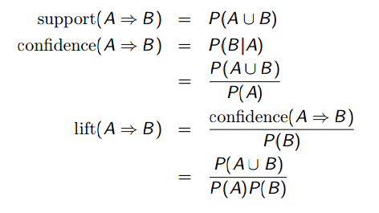
Summary: Association Rules
Association rules are rules presenting association or correlation between itemsets.
where P(A) is the percentage (or probability) of cases containing A.

Slide 24
apriori

Slide 25
Scalable Frequent Itemset Mining Methods
Apriori: A Candidate Generation-and-Test Approach
FPGrowth: A Frequent Pattern-Growth Approach

Slide 26
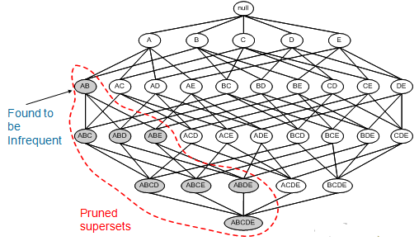
Apriori: A Candidate Generation-and-test Approach
Find the frequent itemsets: the sets of items that have minimum support
A subset of a frequent itemset must also be a frequent itemset
i.e., if {AB} is a frequent itemset, both {A} and {B} should be a frequent itemset
Iteratively find frequent itemsets with cardinality from 1 to k (k-itemset)
Use the frequent itemsets to generate association rules.

Slide 27
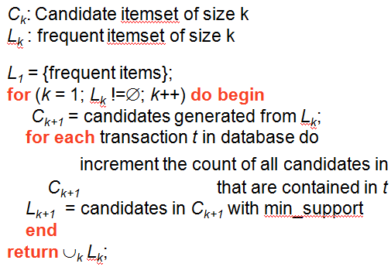
Apriori: A Candidate Generation-and-test Approach
Mathematical Method
Let k=1
Generate frequent itemsets of length 1
Repeat until no new frequent itemsets are identified
Generate length (k+1) candidate itemsets from length k frequent itemsets
Test and count the support of each candidate by scanning the DB
Prune candidate itemsets containing subsets of length k that are infrequent
Eliminate candidates that are infrequent, leaving only those that are frequent
Pseudo-code

Slide 28
Apriori: Assumptions
Assumption: Any subset of a frequent itemset must be frequent
if {beer, diaper, nuts} is frequent, so is {beer, diaper}
Every transaction having {beer, diaper, nuts} also contains {beer, diaper}
True due to the following property of the support measure:
Support of an itemset never exceeds the support of its subsets
This is known as the anti-monotone property of support
Pruning principle: If there is any itemset which is infrequent, its superset should not be generated/tested! (see previous slide)
Agrawal & Srikant 1994, Mannila, et al. 1994
Costly if many item sets, if item sets are large, or if support threshold is low!

Slide 29
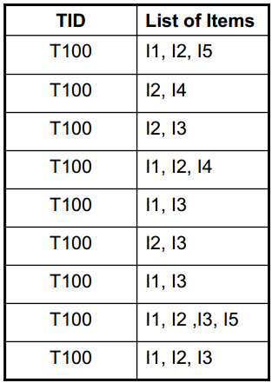
Example 1: Apriori (1)
Consider a database, D , consisting of 9 transactions.
Suppose min. support count required is 2 (i.e. min_sup = 2/9 = 22 % )
Minimum confidence required is 70%.
We have to first find out the frequent itemset using Apriori algorithm.
Then, Association rules will be generated using min. support & min. confidence.

Slide 30
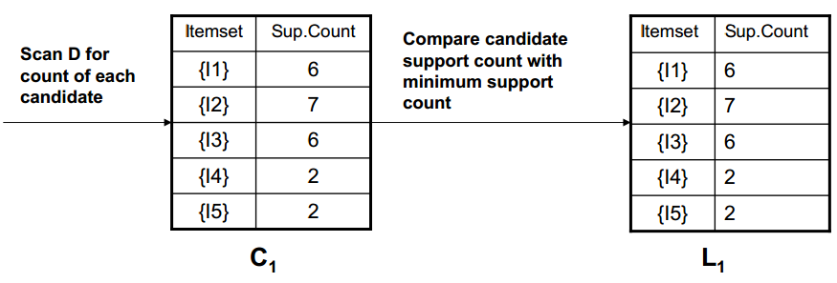
Example 1: Apriori (2)
Step 1: Generating 1-itemset Frequent Pattern
The set of frequent 1-itemsets, L1 , consists of the candidate 1- itemsets satisfying minimum support.
In the first iteration of the algorithm, each item is a member of the set of candidate.

Slide 31
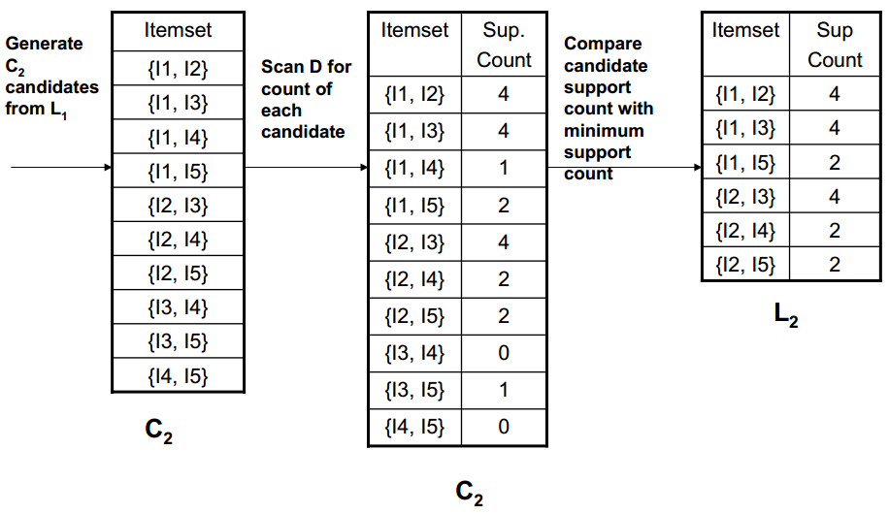
Example 1: Apriori (3)
Step 2: Generating 2-itemset Frequent Pattern
To discover the set of frequent 2-itemsets, L2 , the algorithm uses L1 Join L1 to generate a candidate set of 2-itemsets, C2. Next, the transactions in D are scanned and the support count for each candidate itemset in C2 is accumulated (as shown in the middle table).
2. The set of frequent 2-itemsets, L2 , is then determined, consisting of those candidate 2-itemsets in C2 having minimum support.

Slide 32
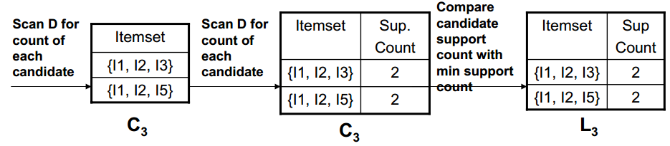
Example 1: Apriori (4)
Step 3: Generating 3-itemset Frequent Pattern
The generation of the set of candidate 3-itemsets, C3 , involves use of the Apriori Property.
In order to find C3, we compute L2 Join L2.
C3 = L2 Join L2 = {{I1, I2, I3}, {I1, I2, I5}, {I1, I3, I5}, {I2, I3, I4}, {I2, I3, I5}, {I2, I4, I5}}.
Now, Join step is complete and Prune step will be used to reduce the size of C3. Prune step helps to avoid heavy computation due to large Ck.

Slide 33
Example 1: Apriori (5)
Step 3: Generating 3-itemset Frequent Pattern
Based on the Apriori property that all subsets of a frequent itemset must also be frequent, we can determine that four latter candidates cannot possibly be frequent. How ?
For example , lets take {I1, I2, I3}. The 2-item subsets of it are {I1, I2}, {I1, I3} & {I2, I3}. Since all 2-item subsets of {I1, I2, I3} are members of L2, We will keep {I1, I2, I3} in C3.
Let’s take another example of {I2, I3, I5} which shows how the pruning is performed. The 2-item subsets are {I2, I3}, {I2, I5} & {I3,I5}.
BUT, {I3, I5} is not a member of L2 and hence it is not frequent violating Apriori Property. Thus We will have to remove {I2, I3, I5} from C3.
Therefore, C3 = {{I1, I2, I3}, {I1, I2, I5}} after checking for all members of result of Join operation for Pruning.
Now, the transactions in D are scanned in order to determine L3, consisting of those candidates 3-itemsets in C3 having minimum support.

Slide 34
Example 1: Apriori (7)
Step 4: Generating 4-itemset Frequent Pattern
The algorithm uses L3 Join L3 to generate a candidate set of 4-itemsets, C4. Although the join results in {{I1, I2, I3, I5}}, this itemset is pruned since its subset {{I2, I3, I5}} is not frequent.
Thus, C4 = φ , and algorithm terminates, having found all of the frequent items. This completes our Apriori Algorithm.
What’s Next ?
These frequent itemsets will be used to generate strong association rules ( where strong association rules satisfy both minimum support & minimum confidence).

Slide 35
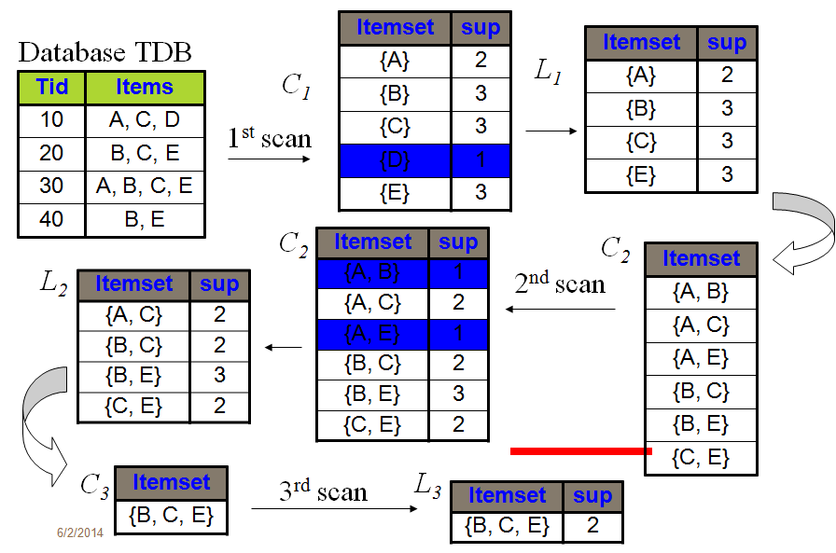
Example 1: Apriori—Summary
minsup = 2

Slide 36
Example 1: Apriori (8)
Step 5: Generating Association Rules from Frequent Itemsets
Procedure:
For each frequent itemset “l”, generate all nonempty subsets of l.
For every nonempty subset s of l, output the rule “s Æ (l-s)” if support_count(l) / support_count(s) >= min_conf where min_conf is minimum confidence threshold.
Back To Example:
We had L = {{I1}, {I2}, {I3}, {I4}, {I5}, {I1,I2}, {I1,I3}, {I1,I5}, {I2,I3}, {I2,I4}, {I2,I5}, {I1,I2,I3}, {I1,I2,I5}}.
Lets take l = {I1,I2,I5}.
Its all nonempty subsets are {I1,I2}, {I1,I5}, {I2,I5}, {I1}, {I2}, {I5}.

Slide 37
Example 1: Apriori (9)
Step 5: Generating Association Rules from Frequent Itemsets
R1: I1 ^ I2 Æ I5
Confidence = sc{I1,I2,I5}/sc{I1,I2} = 2/4 = 50%
R1 is Rejected.
R2: I1 ^ I5 Æ I2
Confidence = sc{I1,I2,I5}/sc{I1,I5} = 2/2 = 100%
R2 is Selected.
R3: I2 ^ I5 Æ I1
Confidence = sc{I1,I2,I5}/sc{I2,I5} = 2/2 = 100%
R3 is Selected.
R4: I1 Æ I2 ^ I5
Confidence = sc{I1,I2,I5}/sc{I1} = 2/6 = 33%
R4 is Rejected.
R5: I2 Æ I1 ^ I5
Confidence = sc{I1,I2,I5}/{I2} = 2/7 = 29%
R5 is Rejected.
R6: I5 Æ I1 ^ I2
Confidence = sc{I1,I2,I5}/ {I5} = 2/2 = 100%
R6 is Selected
If minimum confidence threshold is 70%
In this way, we have found three strong association rules..

Slide 38
Example 2: Apriori
A supermarket tracks sales data by stock-keeping unit (SKU) for each item and logs them in its transaction database as sets that were bought together.
Itemsets
{1,2,3,4}
{1,2,4}
{1,2}
{2,3,4}
{2,3}
{3,4}
{2,4}
Decision: An item set is frequent if it appears in at least 3 transactions of the database; hence, support threshold=3
Process:
Count number of occurrences (=support) of each member item separately, by scanning the database a first time
Item | Support
{1} | 3
{2} | 6
{3} | 4
{4} | 5
2. Generate a list of all pairs of frequent items
Item | Support
{1,2} | 3
{1,3} | 1
{1,4} | 2
{2,3} | 3
{2,4} | 4
{3,4} | 3
All >3 → frequent
> minimum support of 3 ➔ frequent. {1,3} and {1,4} are not frequent, so any larger set which contains {1,3} or {1,4} cannot be frequent.
3. Look for frequent triplets ≥ 3, excluding all that contain {1,3} or {1,4} → none!

Slide 39
Important Details of Apriori
How to generate candidates?
Step 1: self-joining L_{k}
Step 2: pruning
Example of Candidate-generation
L₃={abc, abd, acd, ace, bcd}
Self-joining: L₃*L₃
abcd from abc and abd
acde from acd and ace
Pruning:
acde is removed because ade is not in L₃
C₄={abcd}
Suppose the items in L_{k-1} are listed in an order
Step 1: self-joining L_{k-1}
insert into C_{k}
select p.item₁, p.item₂, …, p.item_{k-1}, q.item_{k-1}
from L_{k-1} p, L_{k-1} q
where p.item₁=q.item₁, …, p.item_{k-2}=q.item_{k-2}, p.item_{k-1} < q.item_{k-1}
Step 2: pruning
∀ itemsets c in C_{k} do
∀ (k-1)-subsets s of c do
if (s is not in L_{k-1}) then delete c from C_{k}
Apriori Implementation

Slide 40
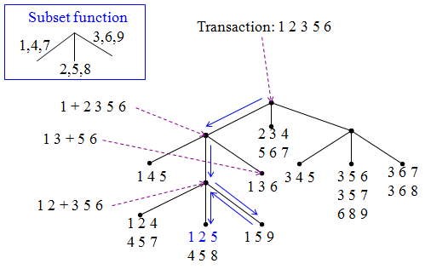
Problem: How to Count Supports of Candidates?
Why is counting supports of candidates a problem?
The total number of candidates can be very huge
One transaction may contain many candidates
Method:
Candidate itemsets are stored in a hash-tree
Leaf node of hash-tree contains a list of itemsets and counts
Interior node contains a hash table
Subset function: finds all the candidates contained in a transaction
Hard to get good performance out of pure SQL (SQL-92) based approaches; use object-relational extensions like UDFs, BLOBs, Table functions etc.

Slide 41
Example: Reducing Number of Comparisons
Candidate counting:
Scan the database of transactions to determine the support of each candidate itemset
To reduce the number of comparisons, store the candidates in a hash structure
Instead of matching each transaction against every candidate, match it against candidates contained in the hashed buckets

Slide 42
improving apriori

Slide 43
Improving Apriori
Hash-based itemset counting: A k-itemset whose corresponding hashing bucket count is below the threshold cannot be frequent.
Transaction reduction: A transaction that does not contain any frequent k-itemset is useless in subsequent scans.
Partitioning: Any itemset that is potentially frequent in DB must be frequent in at least one of the partitions of DB.
Sampling: mining on a subset of given data, lower support threshold + a method to determine the completeness.
Dynamic itemset counting: add new candidate itemsets only when all of their subsets are estimated to be frequent.
Challenges
Multiple scans of transaction database
Huge number of candidates
Tedious workload of support counting for candidates
Improving Apriori:
Reduce passes of transaction database scans
Shrink number of candidates
Facilitate support counting of candidates

Slide 44
Scalable Frequent Itemset Mining Methods
Apriori: A Candidate Generation-and-Test Approach
FPGrowth: A Frequent Pattern-Growth Approach

Slide 45
Apriori In r
Titanic Dataset
Based on Yanchang Zhao http://www.rdatamining.com/docs/association-rule-mining-with-r

Slide 46
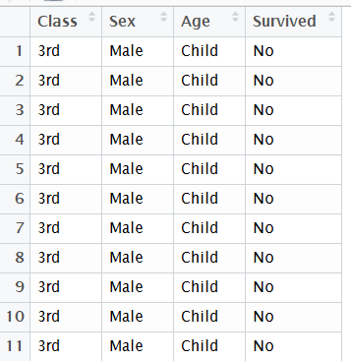
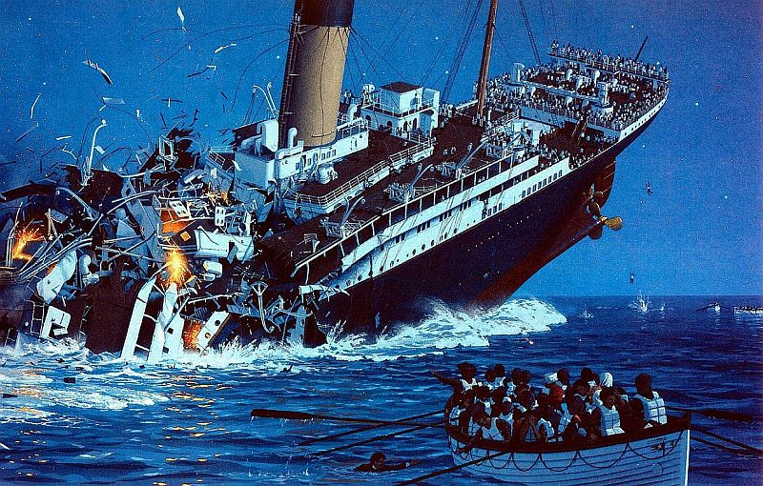
The Example Data Set
The Titanic dataset in the datasets package is a 4-dimensional table with summarized information on the fate of passengers on the Titanic according to social class, sex, age and survival.
Download the reconstructed raw data at http://www.rdatamining.com/data/titanic.raw.rdata .

Slide 47
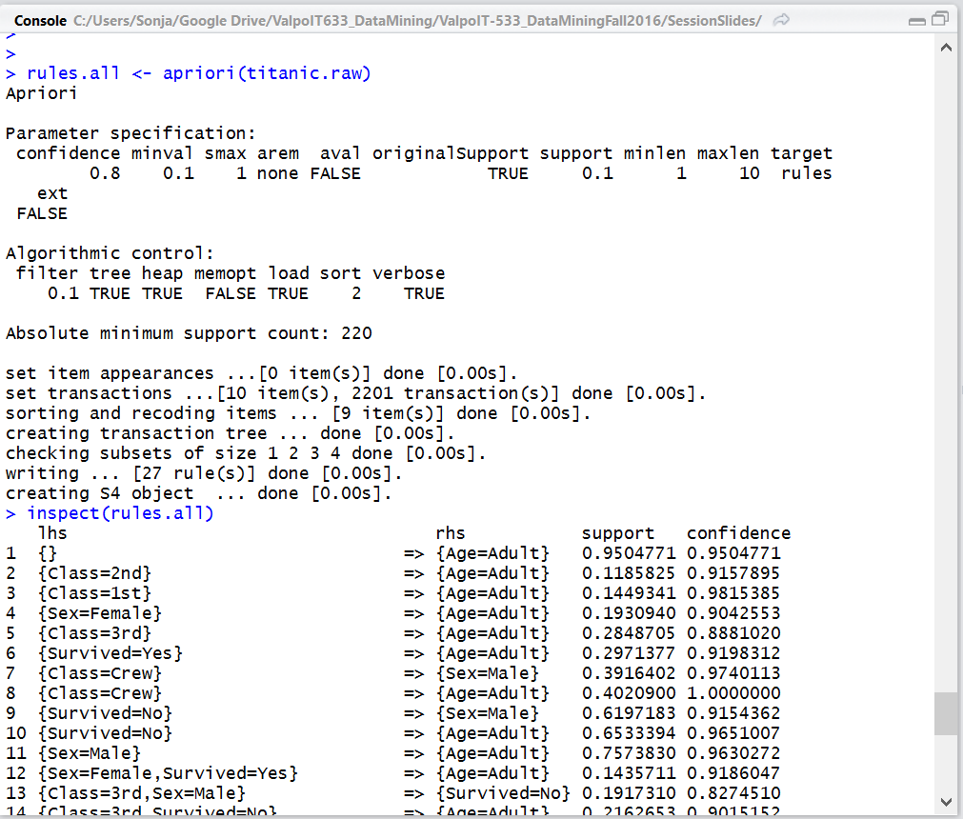
R function apriori()
To mine frequent itemsets, association rules or association hyperedges using the Apriori algorithm. The Apriori algorithm employs level-wise search for frequent itemsets.
Default settings:
minimum support: supp=0.1
minimum confidence: conf=0.8
maximum length of rules: maxlen=10

Slide 48
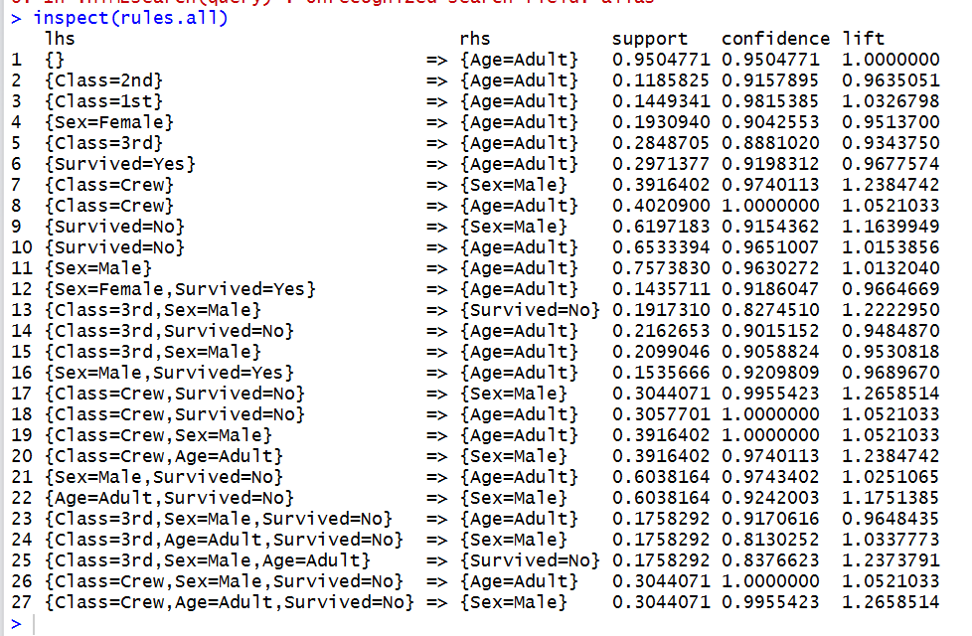

Reading the Rules
Output in order of cols:
Lhs
Rhs
Support
Confidence
Lift
Too much information!
Sorted how?

Slide 49
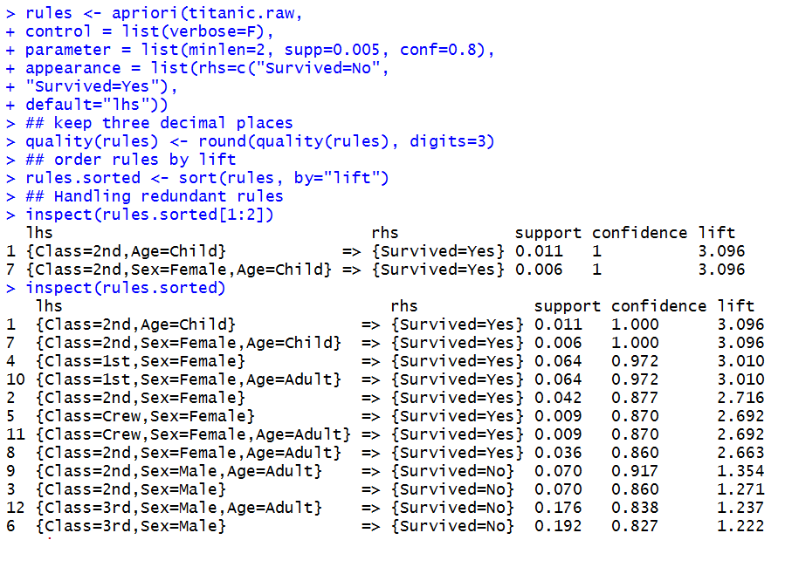
Cleaning Up the Output

Slide 50
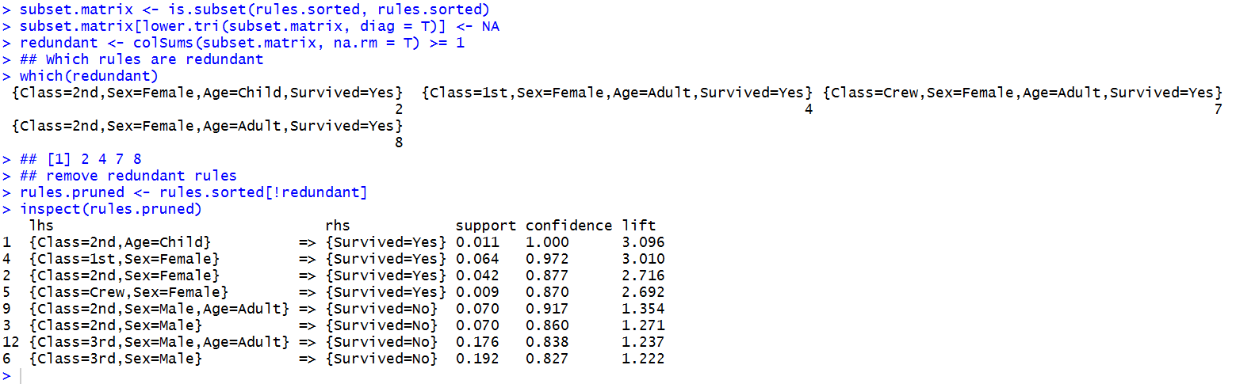

Removing Redundant Rules
Now, we have a clean ruleset … but what does it mean?

Slide 51
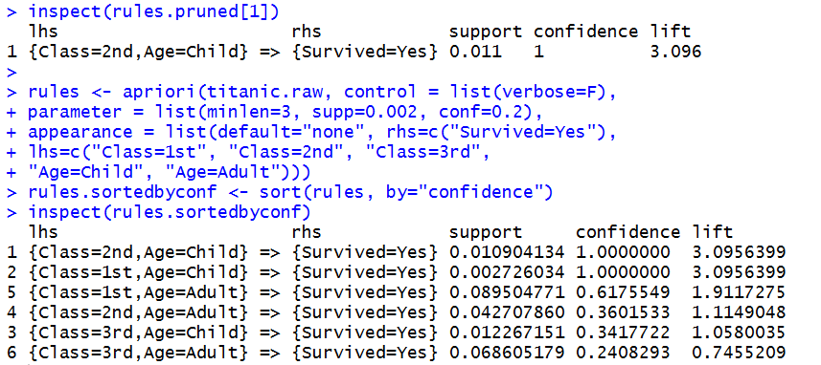
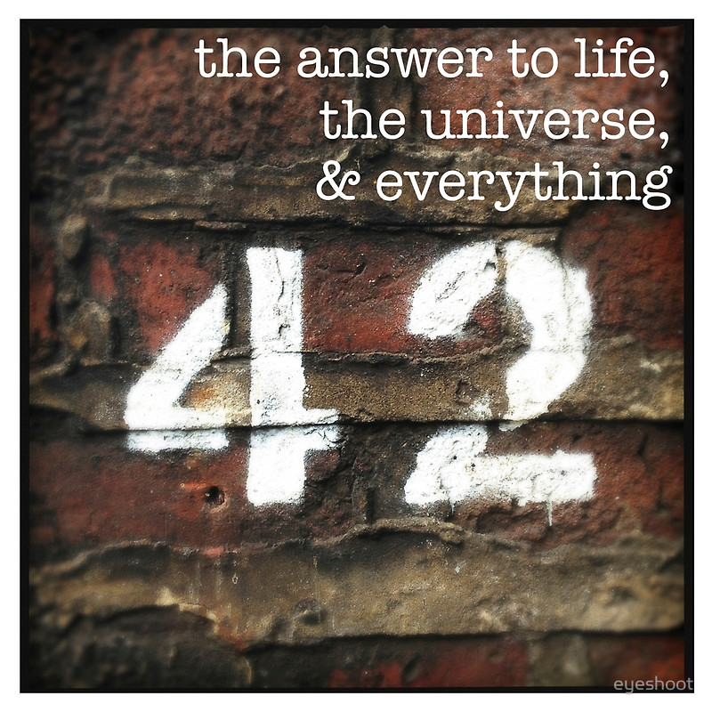
Interpreting the Rules
Did children in 2nd class really have a higher survival rate than anyone else?
It turns out that the children in 2nd class really did have a higher survival rate than anyone else on the Titanic!

Slide 52
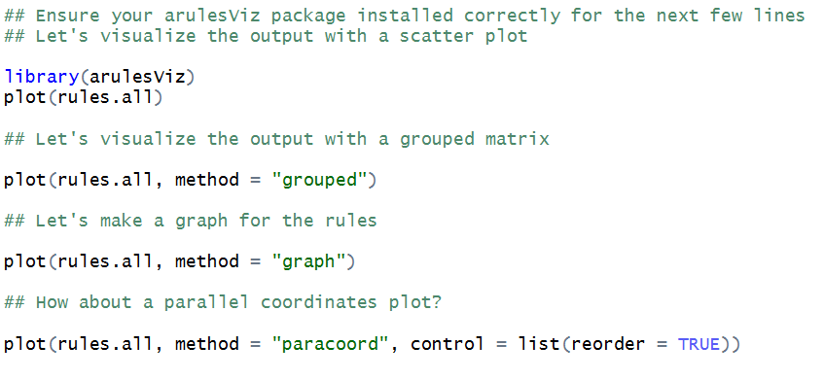
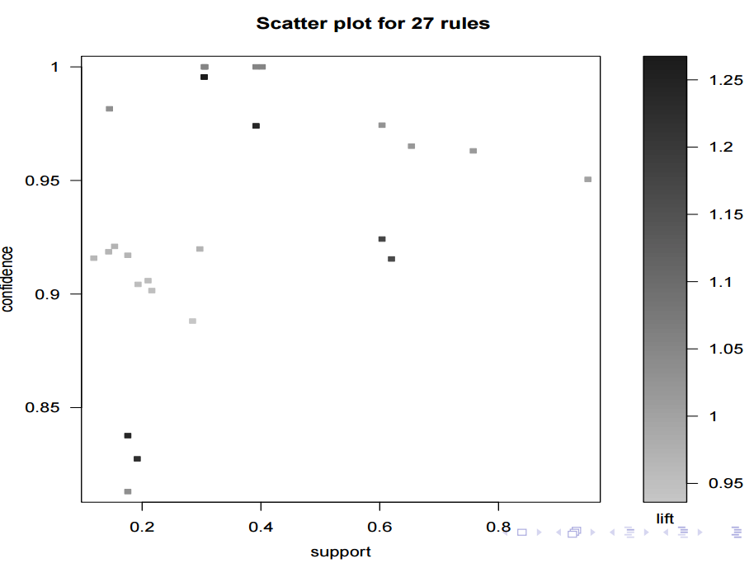
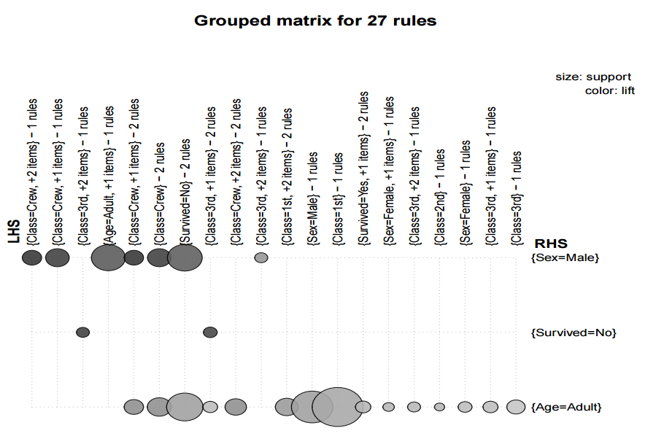
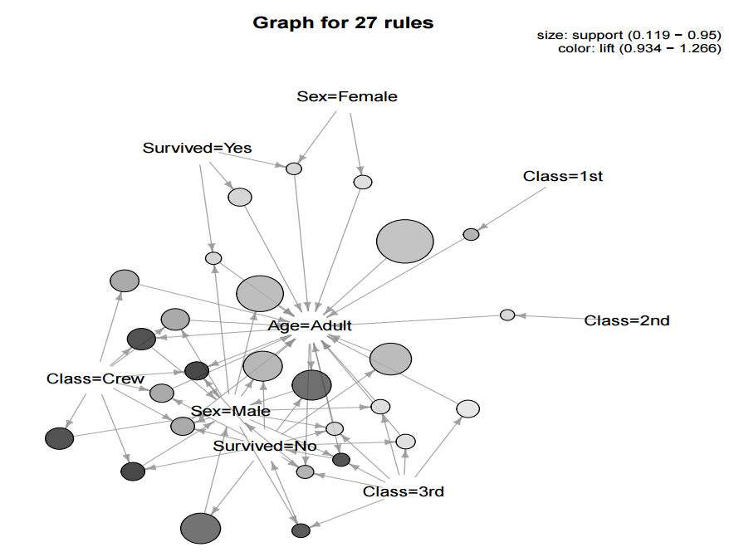
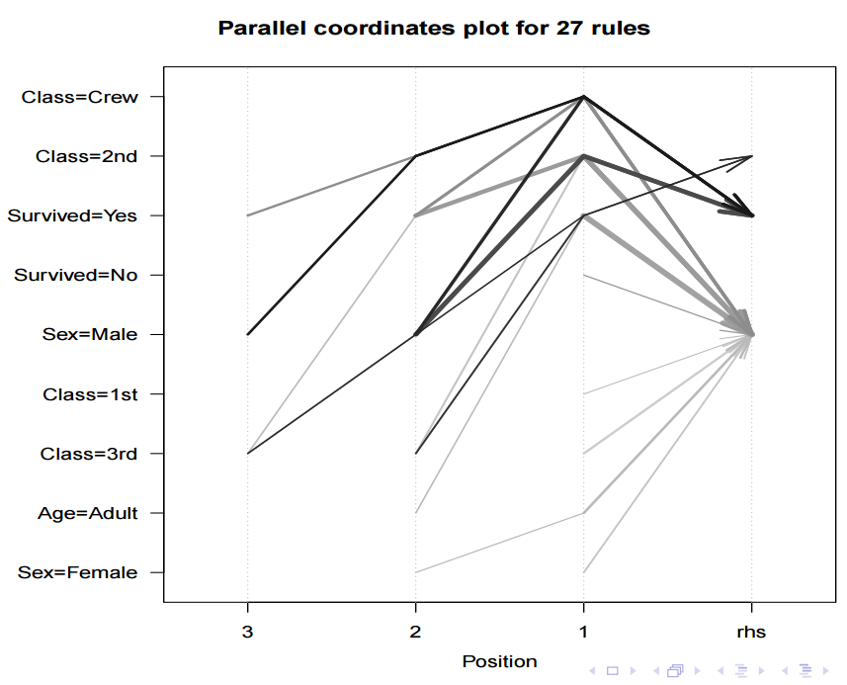
Visualizing Association Rules

Slide 53
Putting it all together: Recommender systems

Slide 54
Recommender Systems
How a recommendation system works.
How social filtering works
How to find similar items
Manhattan distance
Euclidean distance
Minkowski distance
Pearson Correlation Coefficient
Cosine similarity
Implementing k-nearest neighbors in Python
The Book Crossing dataset

Slide 55
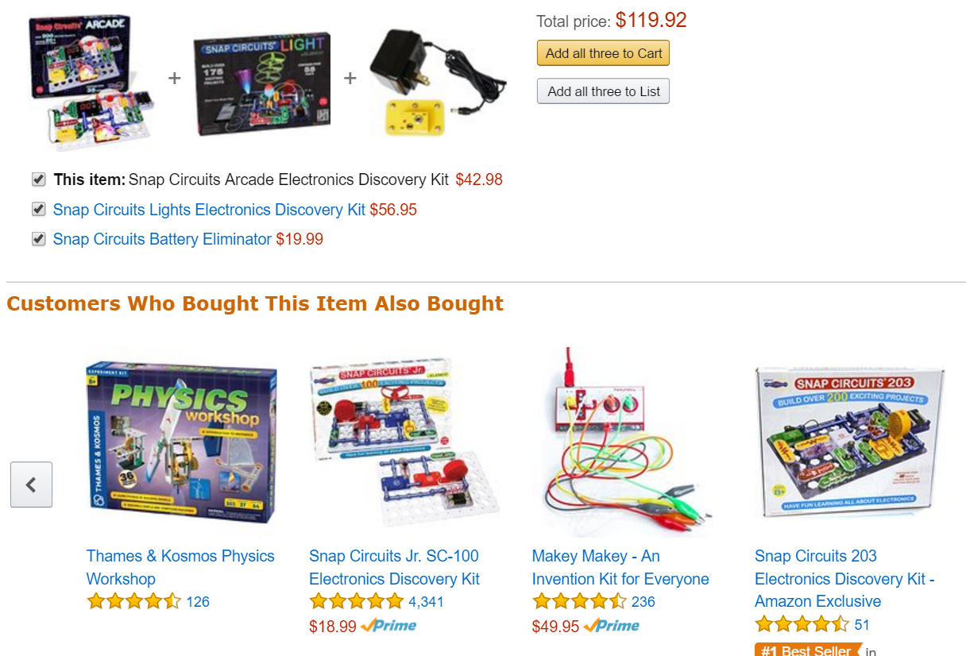

How a Recommender System Works
Customers who are like me!

Slide 56
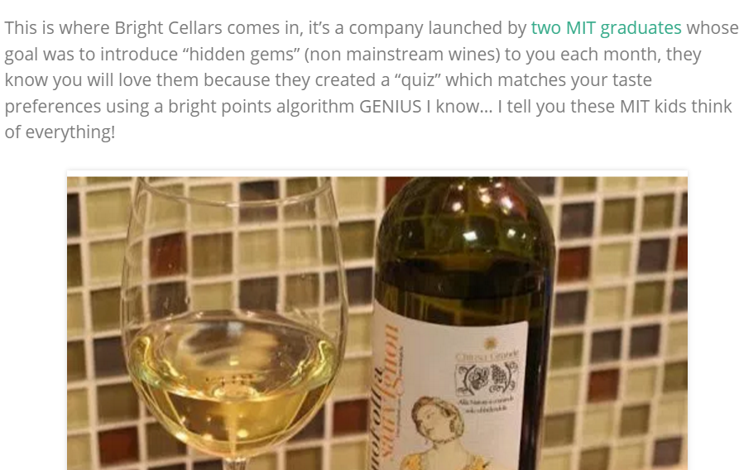
Or like this
It’s all about finding out how data is related.
http://brandcheerleader.com/2015/02/13/bright-cellars-3/?n_id=ff&a_id=fcs

Slide 57
How is data related?
Distance measurements:
Euclidian distance
Manhattan distance
Measurements of Independence:
Chi Square
Covariance
Correlation
Measurements of Comparison:
Regression (single and multiple)
ANOVA
Relationships
Cosine Similarity

Slide 58
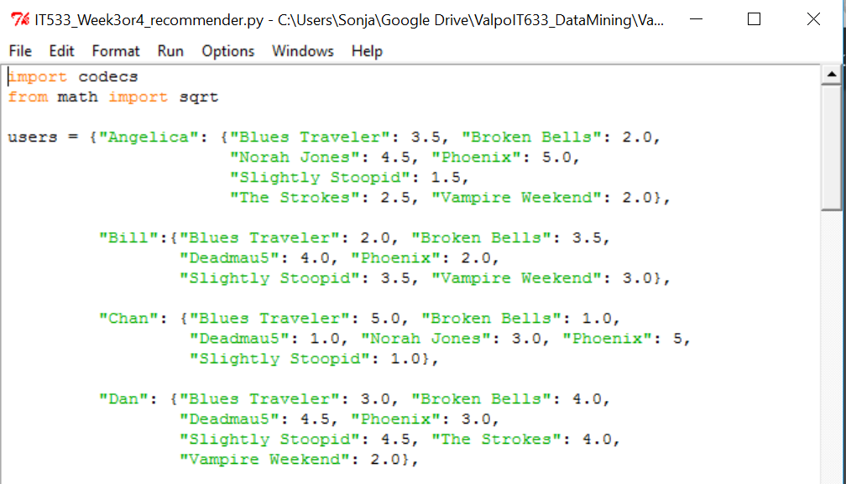
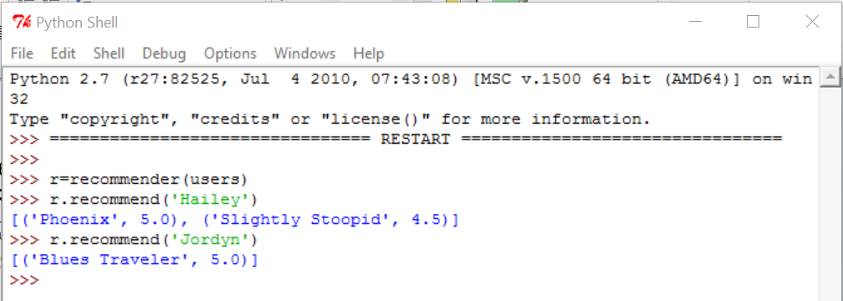
Recommender System
See Zacharias, http://guidetodatamining.com, Ch. 2
Open recommender.py in Python
Select Run > Run Module
Observe the output in the output window
For future reference, you might want to download Canopy, one of the better Python IDEs: https://store.enthought.com/downloads/#default

Slide 59
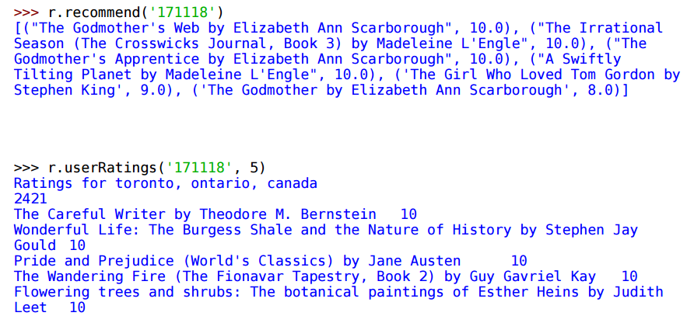
Exploring Python and Recommender Systems
Starting on Zacharias, Chapter 2, p. 54, let’s step through the example together. The data comes from the Book Crossing website. It exists in three files at http://guidetodatamining.com/assets/data/BX-Dump.zip
BX-Users
BX-Books
BX-Book-Ratings
Review the recommender code again and load the book data into Python:
>>> r.loadBookDB(‘<your path>/BX-Dump/')
Then follow the exercise:

Slide 60
Week 5 quiz

Slide 61
Week 5 Quiz
As an extra exercise to Chapter 2, the Guide To Data Minining book website has a file containing movie ratings for 25 movies. Based on the recommender.py code discussed last week and this week:
If you choose to use Python, create a function that loads the data into your classifier. If you choose to use R, set up your script to load the data into your data frame.
If you choose to use Python, add to the recommend method to recommend movies for a specific person. If you choose to use R, follow the apriori instructions earlier in this slide deck and any of the distance formulas discussed in earlier weeks.
Answer the following questions (5 pts each):
What associations have you discovered about the movie ratings?
What is the most prevalent general rule for movie ratings in your dataset? (Remember the children in 2nd class on the Titanic!)
Remember to show your work!

Slide 62
Final project_5

Slide 63
Final Project 5: Apriori
Using R or Python, preprocess your dataset to run with Apriori and then run the Apriori algorithm. Change the support and confidence measures until you get optimal results. Then answer the following questions on one single-spaced page:
How did you adjust support and confidence to achieve optimal results?
Show your work. What do the results tell you about the data?
Remember to include your R or Python solution path and output.

Slide 64
For Next Session
# | Topic | Reading | Due Sunday 11:59 pm CST on Blackboard
6 | Patterns, Associations, Correlations: Frequent Pattern Growth, Measures of Interestingness | Witten/Eibe 6.3, 6.7, 11.7 Zacharski 3 How to Define and Visualize Sentiment Data (Tutorial) YouTube videos as posted | MW Quiz 6: Correlation Exercise S: FINAL_PROJECT_6: Using R, preprocess your dataset to run with Apriori and FP Growth. Then run both algorithms and compare the output. Which algorithm produces better results and why? What do the results tell you about the attributes in your dataset?

